Slide 1
Graphics I
Day I

Slide 2
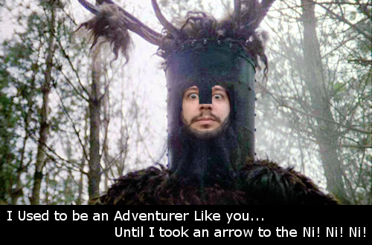
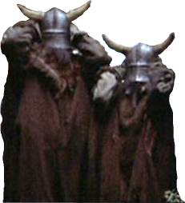
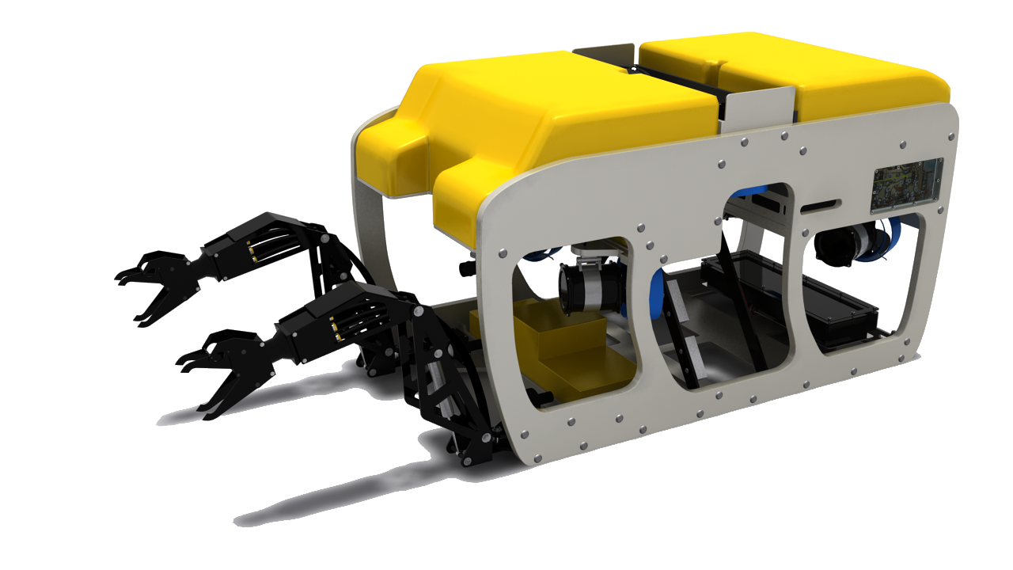
Who are you?!
Sir Dan
Sir John

Slide 3
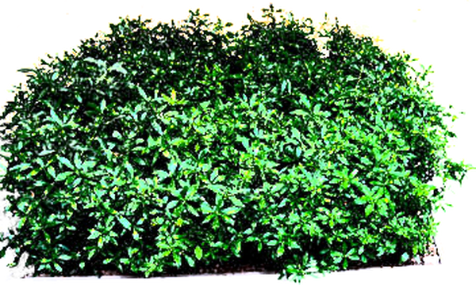
We are the Keepers of the Sacred Words!
Interpolation
Rasterization
Barycentric

Slide 4
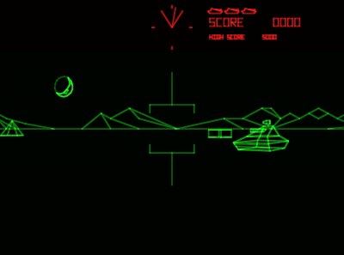

Vector Displays
A type of CRT (cathode ray tube), a vector display would draw lines onto a screen by illuminating the embedded phosphor with it’s electron gun.
Since vector displays drew lines directly they did not use pixels as we know them today.
Many early arcade game from the late 70s to mid 80s preferred the vector display since it allowed for higher detail than equivalent raster displays of the time.

Slide 5
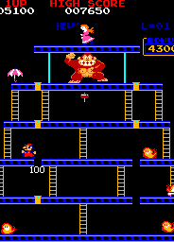
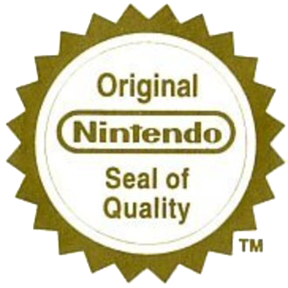
Raster Displays
Although early raster displays also used a CRT, they differed in execution.
A raster display is made up of a grid (the raster) of picture-elements (pixels) where each pixel can be triggered to emit light. Resolution describes the horizontal and vertical number of pixels.
Though we now use other technologies such as liquid crystal display (LCD) in our displays, the concept of the raster and pixel has stayed with us to this day.

Slide 6
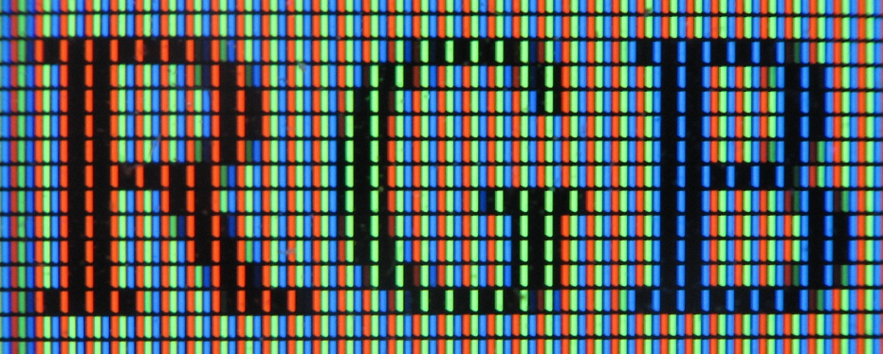
LCD Up Close & Personal
Image courtesy of Wikipedia

Slide 7
What About Alpha?
Alpha is NOT part of the physical display.
We use Alpha data as a kind of extra information to influence our final RGB results in some way.
It’s often up to us (software engineers) on how we use Alpha, however there are certainly some common case uses for it.
One such use is mathematically blending the intensity of two overlapping pixels using the source, destination or some combination of the two values.

Slide 8
Pixel Intensity & Gamma
All modern displays can output up to 255 levels of intensity per color channel. We can store color in many different ways, but this is what the monitor can show.
However… the human perception of this intensity is NOT linear.
This why we use something called “gamma correction”, it adjusts this linear intensity range into something more appropriate for human vision.
Most image formats stored on your hard-drive are stored with the expectation that your display has a gamma ramp of about 2.2.
Pixels retrieved from such an image have been pre-multiplied to compensate for this.

Slide 9
Standard Gamma Correction
γ = ( rgb / MAX_INTENSITY ) ¹
γ = (rgb / MAX_INTENSITY ) ^{2.2}
γ = (rgb / MAX_INTENSITY ) ^{( 1 / 2.2 )}

Slide 10
Pixel Formats
Pixels can be represented internally in LOTS of different ways:
R8G8B8 UINT, R32B32G32A32 FLOAT, B4G4R4 USHORT and on and on…
4Byte colors are very common (ex: X8B8G8R8) since they align well in memory.
Converting between formats is a very common requirement.
The actual formats supported by display hardware will be the fastest to transfer since they will not require conversion.

Slide 11
Working with R8G8B8A8 Pixels
Hexadecimal Is Your Friend!
0xFF0000FF
|
0x00FF00FF
|
0x0000FFFF
0xFFFF00FF
|
0x00FFFFFF
0xFFFFFFFF

Slide 12
Extracting a Single 8bit Channel
Do You Even Shift Bro!?
0x1F4C1FA2
&
0x00FF0000
0x004C0000
>>
Gbyte
==
0x4C

Slide 13
Blending Pixels Based On Alpha
One of the most common ways to use an alpha value, is as a threshold of how much to linearly interpolate between the intensities of 2 pixels.
Step 1: Break each pixel into its raw channels as described previously.
Step 2: Use source pixel’s alpha intensity to determine how much of the destination pixel’s RGB channels should be blended in.
Step 3: Use the linear interpolation formula to merge each of the channels into a final result to be displayed.
The lerp formula: ( B - A ) * R + A
Where A is the starting value and B is the ending value and R is a ratio from 0 to 1 describing the amount of transition desired.
HINT: If R is derived from Alpha then it may not be from 0-1 , you will need to adjust for this.

Slide 14
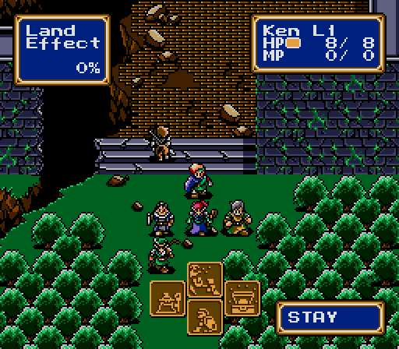
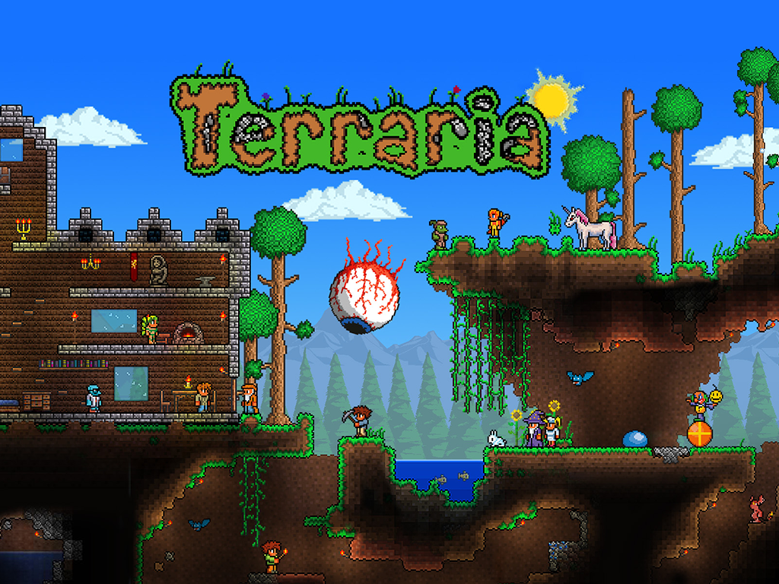


2D Sprite Rendering: Past vs. Present

Slide 15
How many REAL 2D games have you played?
Nearly every modern 2D game is drawn using a 3D Hardware accelerated rendering API like OpenGL or Direct3D.
This means your “Sprites” are actually 2 flat triangles covered with a texture image funneled through a fully 3D capable rendering system.
Modern 2D games/libraries do this because it allows them to take advantage of the GPU (graphics processing unit) and draw far more “Sprites” than they otherwise would be able to.
Older pure 2D systems would use something called a “Blitter“ chip to efficiently transfer image data from one memory area to another.

Slide 16
Polygons…
Polygons Everywhere!!!
There are very good reasons to do this…
But more on that later…

Slide 17
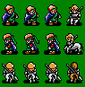
ROM
BLock Image Transfer
COPY PIXELS DIRECTLY
Consider it a slightly more sophisticated “memory copy”
2D Consoles have Blitter Hardware…

Slide 18
Sample Arguments for a BLIT Routine
Pointer to Source Image Array (Pixels)
Pointer to Destination Screen Array (Pixels)
Source Image Array Dimensions (Width & Height)
Destination Screen Array Dimensions (Width & Height)
Source Image Sub-Rectangle to be Copied (ex: Left Top Right Bottom)
Destination Copy-To Location X & Y (Drawing Position)

Slide 19
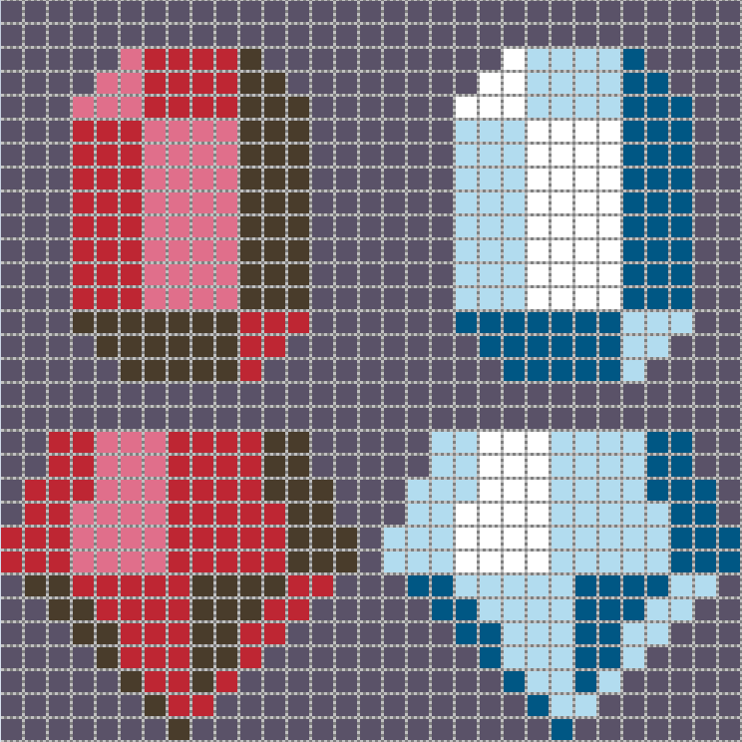
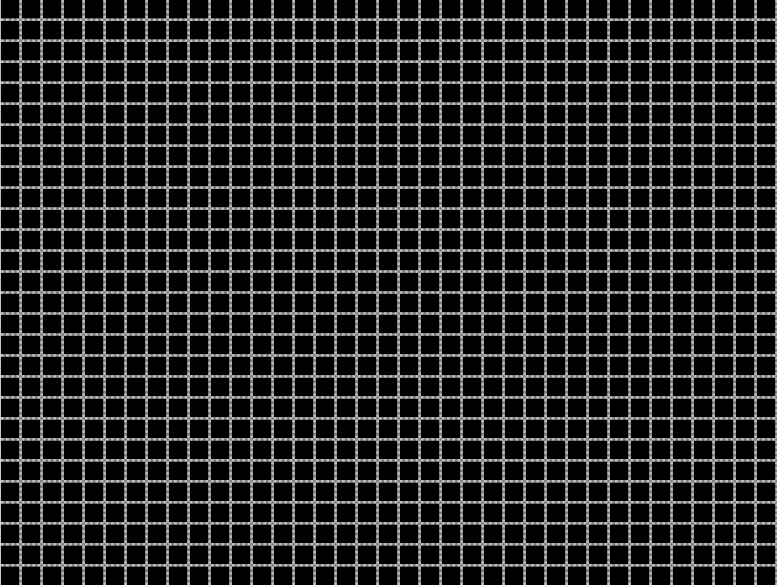
Emulating BLIT Hardware
Source Image Data
Frame Buffer
scanline
Draw X Y
Source Height
Destination Height
TOP
LEFT
RIGHT
BOTTOM
Source Width
Destination Width

Slide 20
For Lab: The Raster Surface
Getting raw color data on the screen in a direct & efficient manner in a modern operating system is non-trivial. To that end I will provide a simple to use three function class that is rather self-explanatory.
The class will allow you to copy pixels directly to the screen. (And that’s it!)
You will actually be writing console programs. (Just like the PG classes!)
In tonight’s lab you will be doing real 2D programming, without the benefit of wrappers and definitely without a 3D API picking up any slack.
It will be just be you, raw arrays of color data & your wits! Oh Boy! =)

Slide 21
Code Along: Working with the Raster Surface Interface
Please Open Your Laptops and Follow Along as We explore using the Raster Surface.
Failing to do so will leave you at a significant disadvantage when lab starts!

Slide 22
Required Reading Assignment
The Final Exam will include some material from reading assignments.
Each reading assignment is designed to prepare you for next class.
For next time read:
In Chapter 2 Miscellaneous Math:
Read sections 2.4 – 2.6
In Chapter 3 Raster Algorithms (From 2nd Edition):
Read sections 3.1 – 3.5
From now on bring the following to class:
Graph & line paper, pencil, handheld calculator.

Slide 23
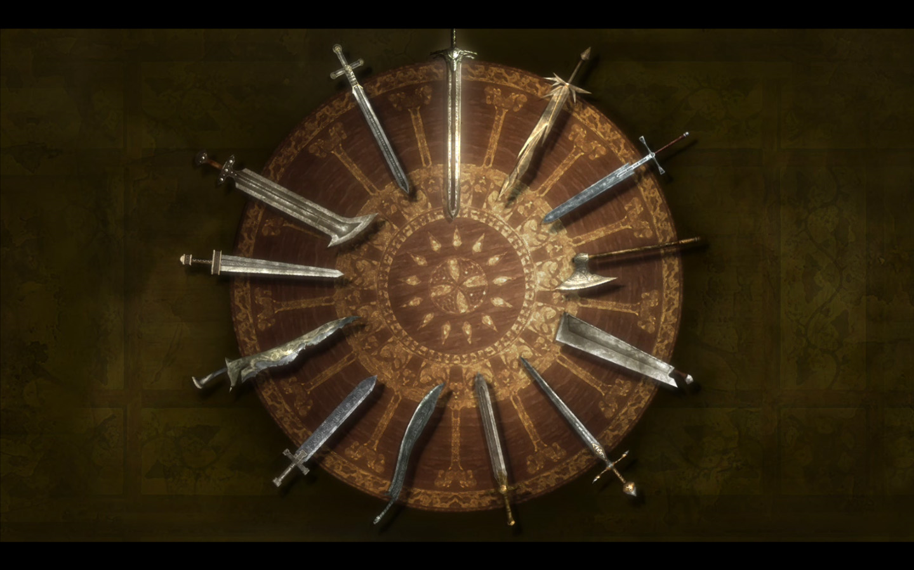
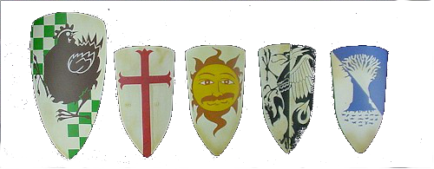
Knights of the Round Table
Jordan Bracken
Michael Jones
Garret Davis
Nicholas Lee
Joshua Stankiewicz
http://killapenguin.com/227/gallery/medium/kingarthur/king-arthur-0191.jpg

Slide 24
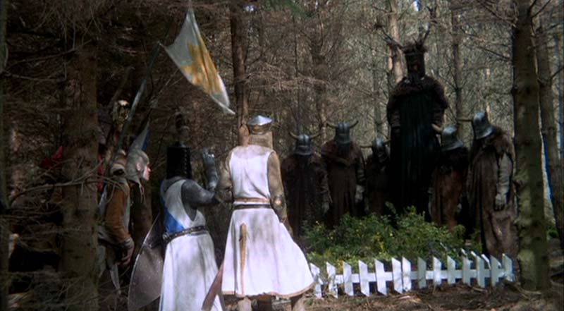
Knights who say Ni!
Matthew Zanini
http://www.intriguing.com/mp/_pictures/grail/large/HolyGrail141.jpg

Slide 25
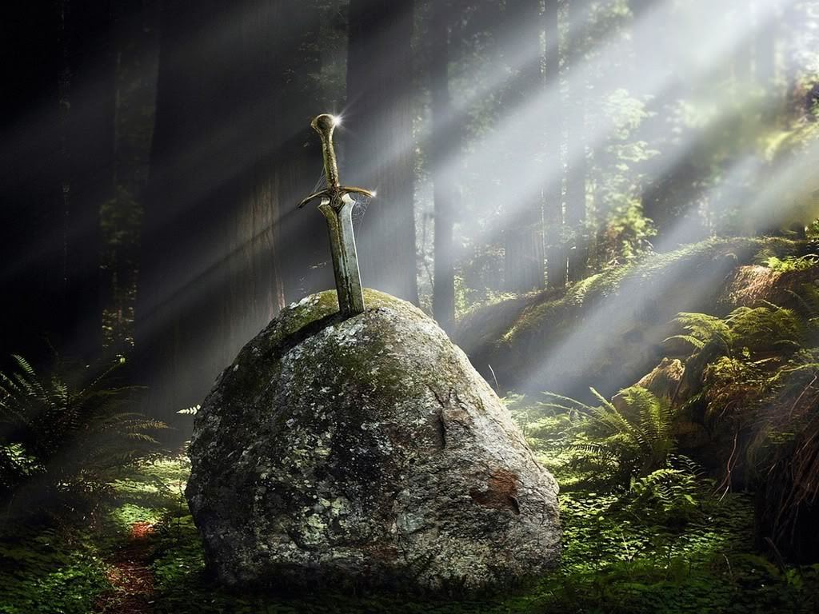
King Arthur
http://images4.fanpop.com/image/photos/17000000/Excalibur-king-arthur-17029845-1024-768.jpg

Slide 26
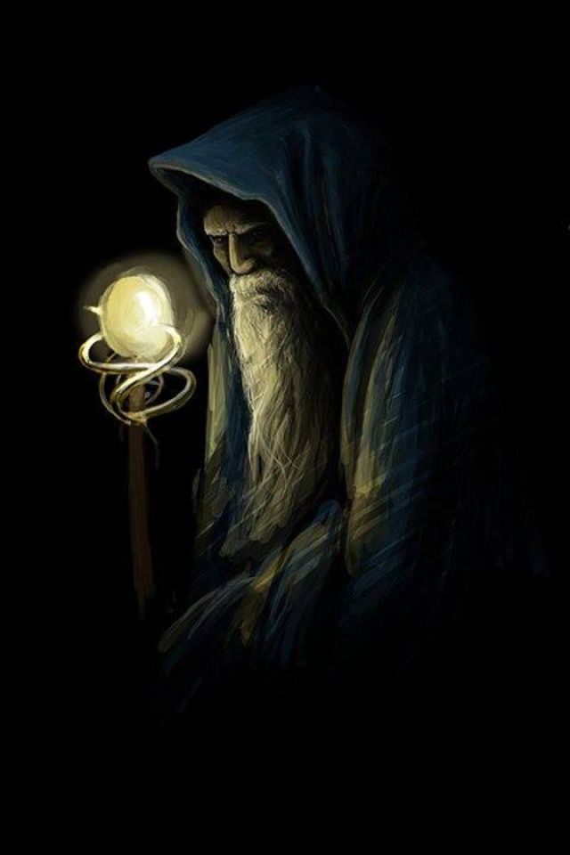
Merlin
Mitchell Martin
http://media-cache-ak0.pinimg.com/736x/ea/47/83/ea4783c4c2ff6fd196eba02286f4f2ac.jpg

Slide 27
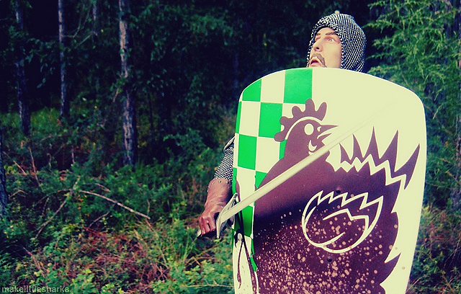
Brave Sir Robin
http://farm7.staticflickr.com/6164/6189078875_c84008e97d_z.jpg

